Slide 1
MEDICAL INSURANCE FORECAST BY REGRESSION MODEL
by
keerthana lakshmi p

Slide 2
What is Machine Learning?
A branch Of artificial intelligence, concerned with the design and development of algorithms that allow computers to evolve behaviour’s based on empirical data
Using known data, develop a model to predict unknown data.
Model: Known data + Algorithms (ML algorithms)
Unknown Data: Missing, Unseen, not existing, future data

Slide 3
WHY MACHINE LEARNING ?
1) Machine learning is important because it gives enterprises a view of trends in customer behavior and operational business patterns, as well as supports the development of new products.
2) Many of today's leading companies, such as Facebook, Google, and Uber, make machine learning a central part of their operations.
3)Today we can see many machine learning real-world examples.
4)We may or may not be aware that machine learning is used in various applications like – voice search technology, image recognition, automated translation, self-driven cars, etc.

Slide 4
Types of ml
* There are primarily three types of machine learning:
1) Supervised learning,
2)Unsupervised learning, and
3) Reinforcement learning

Slide 5
Supervised learning
Some of the most popularly used supervised learning algorithms are:
Linear Regression
Logistic Regression
Support Vector Machine
K Nearest Neighbor
Decision Tree
Random Forest
Naive Bayes

Slide 6
Unsupervised learning
Selecting the right algorithm depends on the type of problem you are trying to solve. Some of the common examples of unsupervised learning are:
K Means Clusterin
Hierarchical Clustering
DBSCAN
Principal Component Analysis

Slide 7
Introduction to insurance regression datasets
Health insurance is insurance that covers the whole or a part of the risk of a person incurring medical expenses, spreading the risk over a large number of persons.
By estimating the overall risk of health care and health system expenses over the risk pool, an insurer can develop a routine finance structure, such as a monthly premium or payroll tax, to provide the money to pay for the health care benefits specified in the insurance agreement. The benefit is administered by a central organization such as a government agency, private business, or not-for-profit entity.
According to the Health Insurance Association of America, health insurance is defined as “coverage that provides for the payments of benefits as a result of sickness or injury. It includes insurance for losses from accident, medical expense, disability, or accidental death and dismemberment”

Slide 8
List of attributes
Age: age of primary beneficiary.
Sex: insurance contractor gender, female, male.
BMI: Body mass index, providing an understanding of body, weights that are relatively high or low relative to height, objective index of body weight (kg/m^2) using the ratio of height to weight, ideally 18.5 to 24.9.
Children: Number of children covered by health insurance/Number of dependents.
Smoker: Is the person a smoker or not.
Region: the beneficiary’s residential area in the US, northeast, southeast, southwest, northwest.
Charges: Individual medical costs billed by health insurance

Slide 9
comparison with all algorithms of ML
Linear regression is one of the easiest and most popular Machine Learning algorithms. It is a statistical method that is used for predictive analysis. Linear regression makes predictions for continuous/real or numeric variables such as sales, salary, age, product price, etc.
Linear regression algorithm shows a linear relationship between a dependent (y) and one or more independent (y) variables, hence called as linear regression.
Linear regression score - 0.759871
LinearRegression() | 0.759871

Slide 10
Random forest regression
Random forest regression is a supervised learning algorithm and bagging technique that uses an ensemble learning method for regression in machine learning.
The trees in random forests run in parallel, meaning there is no interaction between these trees while building the trees.
Random forest regression score - 0.834188

Slide 11
Decision tree regression
Decision tree builds regression or classification models in the form of a tree structure.
It breaks down a dataset into smaller and smaller subsets while at the same time an associated decision tree is incrementally developed.
Decision tree regression - 0.750738

Slide 12
AdaBoost Regressor
AdaBoost stands for “Adaptive Boosting”. Adaptive because the models are built one after the other and the performance of the previous models influences the model-building process of the following models.
Next to Bagging, Boosting is the best-known ensemble method.
AdaBoost regressor - 0.714667

Slide 13
Gradientboostingregressor
Gradient boosting is a machine learning technique used in regression and classification tasks, among others.
It gives a prediction model in the form of an ensemble of weak prediction models, which are typically decision trees.
Gradient boosting score - 0.829430

Slide 14
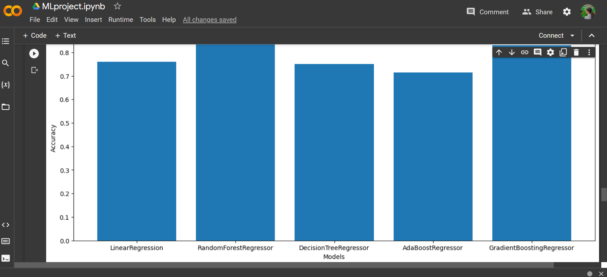
Comparasion of all model with help of chart

Slide 15
conclusion
The results obtained above can be used as a standard point of reference for other comparative studies done in the field of predicting values from insurance data.
This comparative study can further be used as a basis for improving the present regression and techniques resulting in making better technologies for accurately predicting insurance price of an individual.

